Slide 1
Theory of Elasticity in Geotechnical Engineering
Lecture
Hadush Seged (Dr.)
December 15, 2009

Slide 2
Hooke’s Law – stress strain relations
The strain-displacement relations (Eqn. 4.22) and the equations of equilibrium (Eqn. 5.19) are independent of the material properties. Hence, they are applicable to any cases having linear elastic infinitesimal deformation.
Hooke’s law, on the other hand, couples the characteristics of elasticity and material properties via the stress-strain relations.
Hooke’s law is the glue that binds the theory of elasticity together. It provides the missing equations that relate the stresses and strains at all points within the body.
Robert Hooke (1676) stated that the force needed to elongate a spring is a linear function of the stresses.

Slide 3
However, The form of Hooke’s law we will need is a little more complicated than the form Robert Hooke proposed in 1676. Hooke was concerned with springs in stead of 3D continuum.
We will need to generalize Hooke’s idea and let the strains be linear functions of the stresses. The result is often called the generalized Hooke’s law.
The generalized Hooke’s law is an example of a constitutive relation. In continuum mechanics, constitutive equations are equations that relate causes and effects. Stress and strain are one example of cause and effect.

Slide 4
All constitutive equations involve one or more parameters and these parameters will take different values for different materials.
The material parameters required for the generalized Hooke’s law are called the elastic constants. There are five elastic constants, but not all are independent.
If any two of the constants are known the other three can be found from simple algebraic relationships.
Of the five elastic constants, four relate strains to stresses (or vice versa) while the fifth, Poisson’s ratio, relates one extensional strain to another.

Slide 5

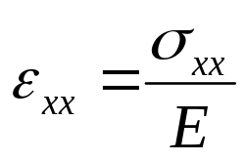
Young’s modulus & Poisson’s ratio
The most familiar elastic constants are Young’s Modulus and Poisson’s ratio. Both are illustrated by an elastic bar in uniaxial tension.
The stress σ_{xx} will cause the bar to elongate, which results in extensional strain ε_{xx}.
Based on experimental observations, ε_{xx} depends linearly on σ_{xx} .
...(6.1)
Where E is Young’s modulus. It has dimensions of stress.

Slide 6
Equation (6.1) will be an adequate description of material response for a wide range of materials including soils, provided that the stress does not become too large in comparison with the failure stress.
Experimental observations have also shown that as the bar elongates in response to σ_{xx}, there will also be lateral contraction. The bar grows longer and skinner simultaneously.
The lateral contraction leads to more extensional strains ε_{yy} and ε_{zz}, in the lateral direction.

Slide 7
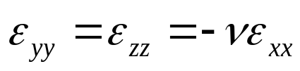
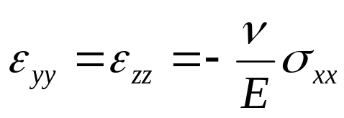
For an isotropic, linear elastic material, ε_{yy} and ε_{zz} will be equal and will both be linear functions of ε_{xx}.
...(6.2)
Where ν is Poisson’s ratio. It is a dimensionless quantity.
Because of Eqn.(6.1), we can re-write Eqn. (6.2) as:
...(6.3)
Equations (6.1) and (6.3) now give all strains in terms of the applied stress σ_{xx}.

Slide 8

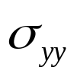
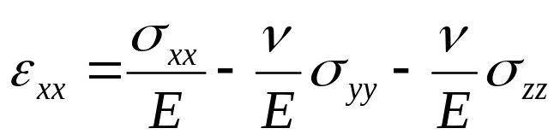
We can generalize the above results by considering a cube of material subjected to uniform normal stress on all six faces.
The extensional strain ε_{xx} will depend on all three stresses.
There will be a contribution from σ_{xx} exactly like equation 6.1 but there will also be a contribution from σ_{yy} and σ_{zz} similar to equation 6.3. The resulting expression for ε_{xx} will be:
...(6.4)

Slide 9
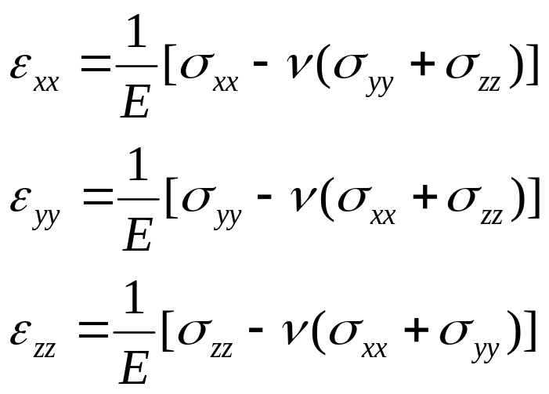
Two similar equations for ε_{yy} and ε_{zz} can be easily written down. Equation (6.4), can, thus, be re-written as:
...(6.5)

Slide 10
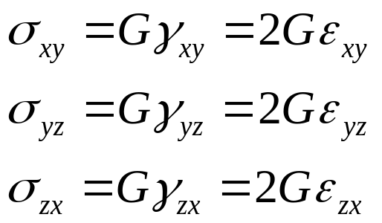
Shear Modulus
The third elastic constant is the shear modulus, G.
The shear modulus G relates the shear stress at a point in the body to the associated shearing strain.
More specifically, G relates the off-diagonal terms of σ_{ij} and ε_{ij} as follows.
...(6.6)

Slide 11
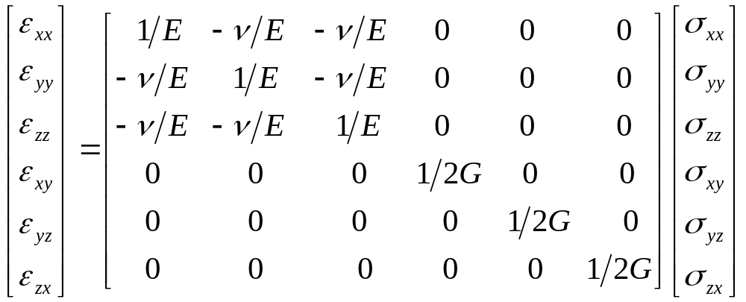
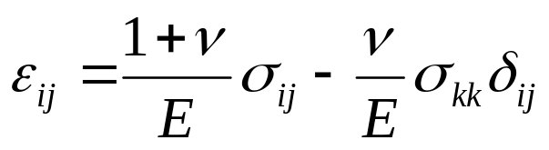
Combining Equations (6.5) and (6.6) gives the following relation, which is known as the Generalized Hooke’s law
...(6.7)
Compliance Matrix
Or
...(6.8)

Slide 12

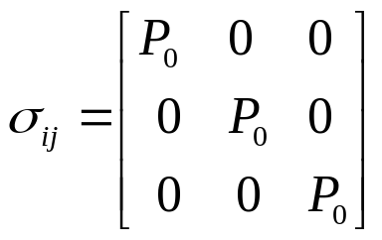
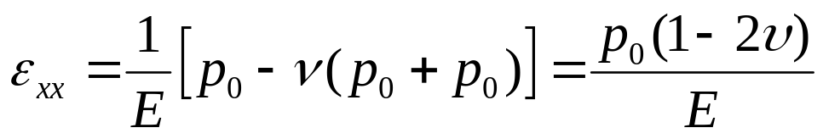
Bulk Modulus
The bulk modulus, denoted as K, relates the sum of the normal stress σ_{xx} + σ_{yy} + σ_{zz}, to the volumetric strain ε_{v}.
Consider a cylindrical body supporting a uniform state of hydrostatic stress, P₀ . The stress tensor has a simple form:
The corresponding extensional strains following Eqn. (6.4) is:

Slide 13
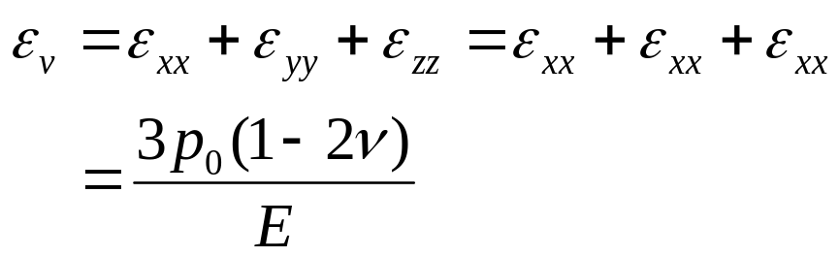

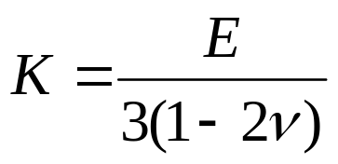
And ε_{yy} and ε_{zz} are the same as ε_{xx} , hence the volumetric strain is:
...(6.8)
The bulk modulus is defined as:
...(6.9)
Comparing equations (6.7) and (6.9) we have:
...(6.10)

Slide 14
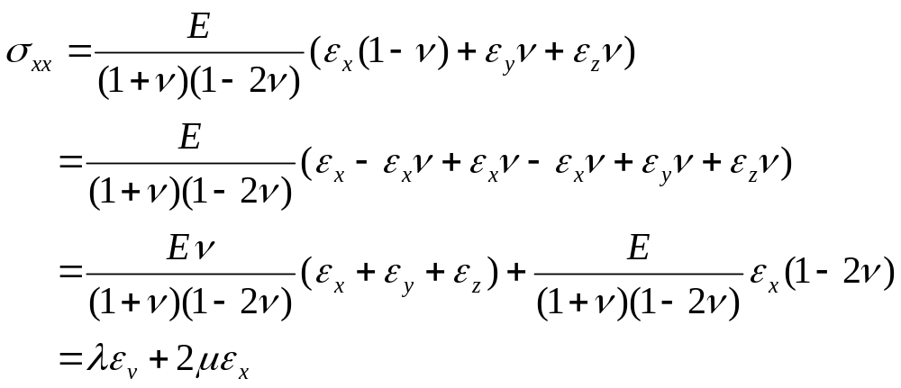
Lame Constants
Inverting equation (6.5) gives the following relation for the normal stress in terms of normal strain:
0

Slide 15
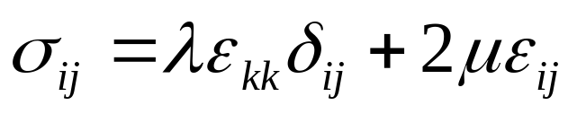
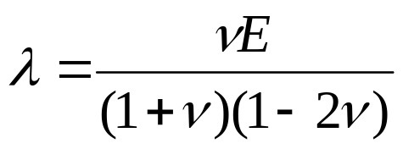
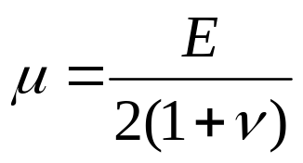
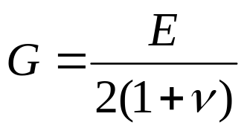
Therefore, the generalized Hook’s law can be written in a form:
...(6.11)
λ and μ are called the first and the second Lame constants.
...(6.12)
...(6.13)
the shear modulus G is considered as the second Lame constant, the same as μ . Hence,
...(6.14)

Slide 16
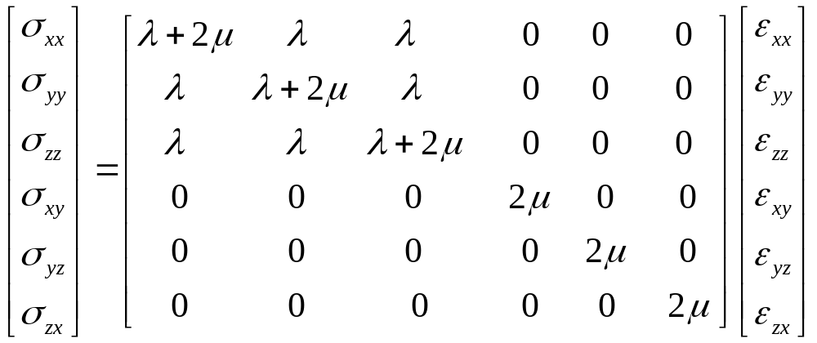
Writing Equation (6.11) in matrix form gives:
...(6.16)
However, for many people the most familiar elastic constants are Young’s modulus E and Poisson’s ratio ν.

Slide 17
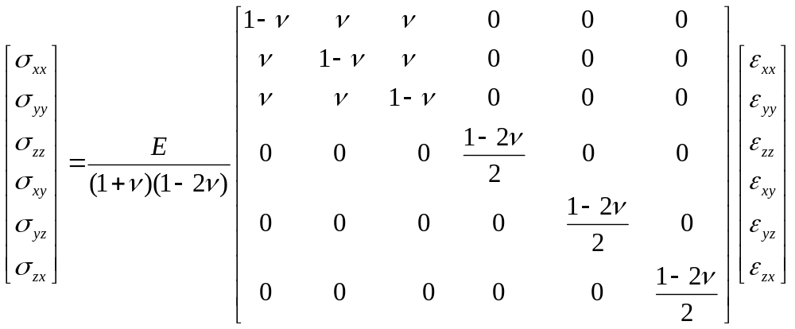
Hence, Equation (6.16) is usually written as:
Stiffness Matrix
...(6.17)

Slide 18



Stress and strain deviators
In linear theory of elasticity, the generalized Hooke’s law is decomposed into two completely separate parts.
The first part dealing with changes in volume and the mean stress, and the second part dealing with changes in shape and the deviatoric stress (the stress part that causes distortion).
The first part is obtained by taking the trace of both sides of equation (6.11):
...(6.18)
Note that trδ_{ij} = 3. We know that the mean stress is given by
...(6.19)

Slide 19

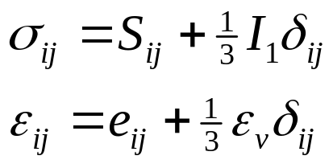
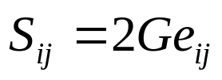
Comparing Equations (6.9) and (6.19), we see that:
...(6.20)
Similar simple relations can also be obtained for the second part dealing with the devaitoric stress and devaitoric strain.
We know that:
Substituting the above equations into equation (6.9), simplifying and using equation (6.18), we have:
...(6.21)

Slide 20
Relations between elastic constants
Any of the five constants E,ν, G, K, λ, can be expressed in terms of any two other constants.
Therefore, only two of the five constants are needed to characterize the material.
Results of the different relations between the elastic constants are conveniently summarized in the table below.

Slide 21
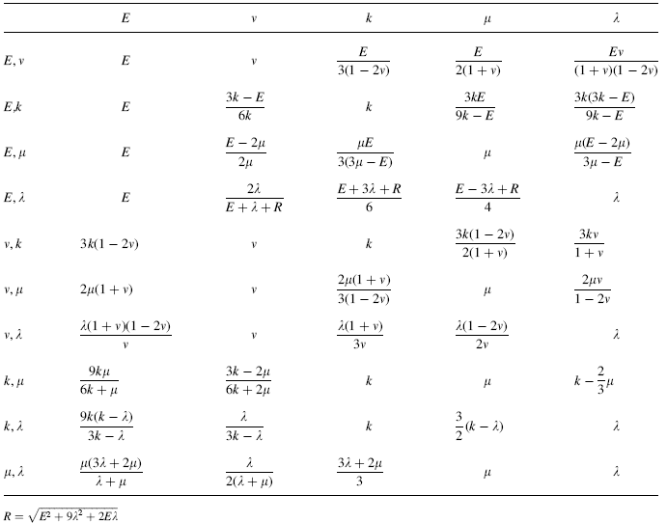
Relations between elastic constants
or G

Slide 22
Strain Energy and Related Principles
Surface (boundary) tractions and body forces will do work on an elastic solid, and this work will be stored inside the material in the form of strain energy.
For the elastic case, removal of these loadings results in complete recovery of the stored energy within the body.
Development of strain energy concepts can yield new and useful information not found by other methods.

Slide 23
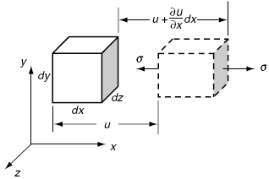
Consider the simple uniform uniaxial deformation case with no body forces, as shown in the figure.
The cubical element of dimensions dx, dy, dz is under the action of a uniform normal stress in the x-direction as shown.
During this deformation process, it is assumed that the stress increases slowly from zero to σ_{x}, such that inertia effects can be neglected.

Slide 24
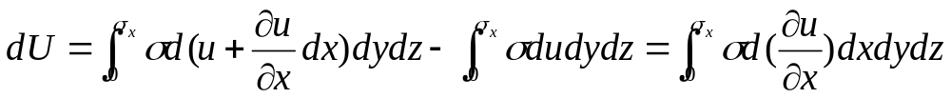
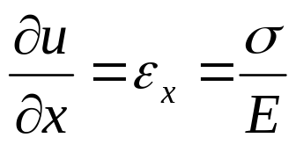
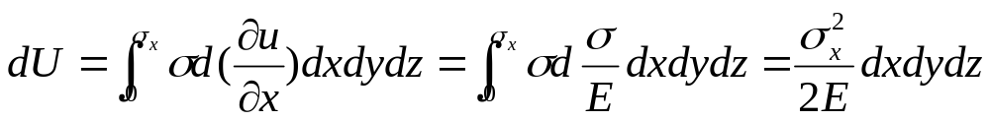
The strain energy stored is equal to the net work done on the element, and this is given by:
...(6.22)
Using the strain displacement relations and Hooke’s law:
...(6.23)
Hence, equation 6.22 becomes:
...(6.24)

Slide 25
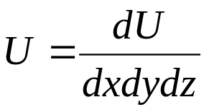
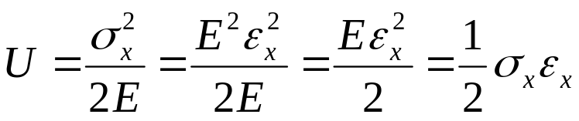
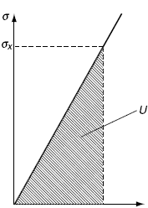


The strain energy per unit volume, or strain energy density, is specified by:
...(6.24)
Hence,
...(6.25)
This result can be interpreted from the stress-strain curve. Because the material is linear elastic, the strain energy for the uniaxial case is simply the shaded area under the stress-strain curve.

Slide 26
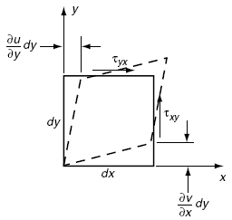
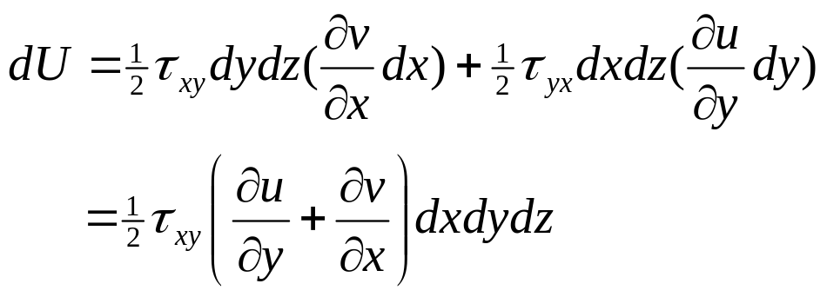
Next, we will see the strain energy caused by the action of uniform shear stress. Consider the same cube under uniform τ_{xy} and τ_{yx} loading, as shown in figure below.
Using similar analysis, the strain energy is obtained to be:
...(6.26)

Slide 27
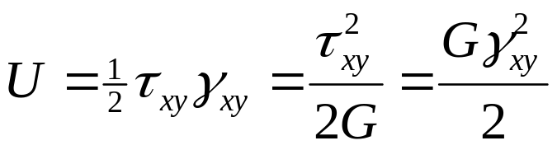
and thus the strain energy density can be expressed by:
...(6.27)
Results from the previous two cases (6.25) and (6.27) indicate that the strain energy is not a linear function of the stresses or strains, and thus the principle of superposition cannot be directly applied to develop the strain energy for a multidimensional state of stress.
However, from conservation of energy, the work done does not depend on the order of loading application, but only on the final magnitudes of the stresses and strains.

Slide 28
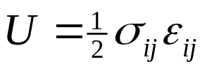
This concept then allows normal and shear loadings to be applied one at a time and produces an additive total strain energy for a general three-dimensional state of stress and strain.
...(6.28)
...(6.29)
We know that the generalized Hooke’s law can be written as:
or

Slide 29
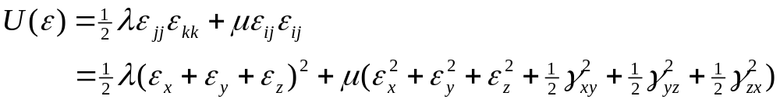
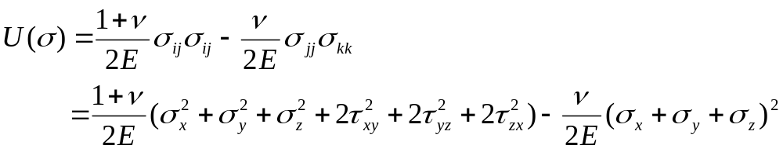
Using the above Hooke’s law, the stresses can be eliminated from relation (6.29) and the strain energy can be expressed solely in terms of strain.
...(6.29)
Likewise, the strains can be eliminated and the strain energy can be written in terms of stress
...(6.30)

Slide 30

Reviewing the developed forms in terms of the stresses or strains, it is observed that the strain energy is a positive definite quadratic form with the property:
...(6.31)
for all values of σ_{ij} and ε_{ij}, with equality only for the case with σ_{ij} =0 or ε_{ij} = 0.
Actually, relation (6.31) is valid for all elastic materials, including both isotropic and anisotropic solids.

Slide 31
Bounds on the Elastic Constants
Can the elastic constants take on any value, or are there contraints they must obey?
The answer is that all five constants are constrained, at least from below.
Strain energy concepts allow us to generate particular bounds on elastic constants.
Consider the following three stress states previously discussed

Slide 32
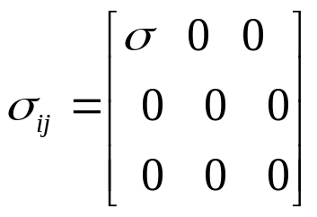
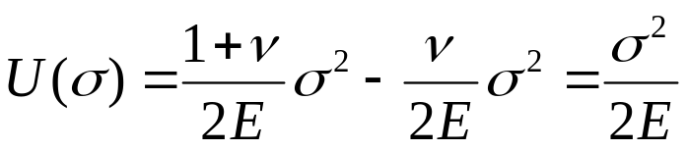

Uniaxial stress state
Uniform uniaxial deformation in the x-direction is given by the stress state.
For this case, the strain energy reduces to:
...(6.32)
Because the strain energy is positive definite, relation (6.32) implies that the modulus of elasticity must be positive
...(6.33)

Slide 33
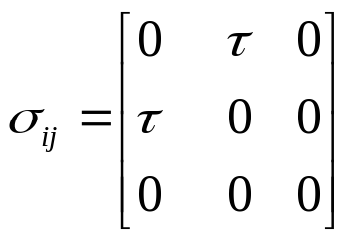
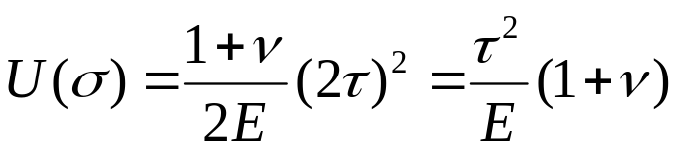

Simple shear
Consider next the case of uniform simple shear defined by the stress tensor.
For this case, the strain energy reduces to:
...(6.34)
Again, invoking the positive definite property of the strain energy and using the previous result of E > 0 gives
...(6.35)

Slide 34
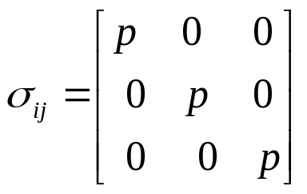
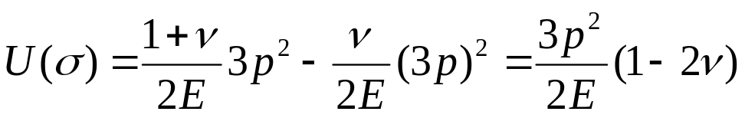
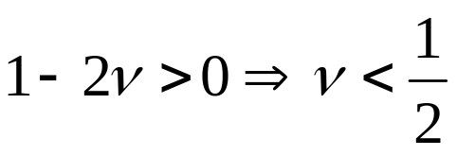
Hydrostatic compression
The final example is chosen as uniform hydrostatic compression specified by
Evaluating the strain energy yields:
...(6.36)
Using the positive definite property of the strain energy and E > 0 gives
...(6.37)

Slide 35
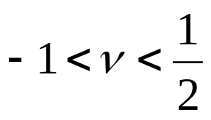

Combining relations (6.35) and (6.37) places the following bounds on Poisson’s ratio:
...(6.38)
Using relations between the elastic constants given in the previous Table, the above results also imply that:
...(6.39)
Experimental evidence indicates that most real materials have positive values of Poisson’s ratio, and thus 0 < ν < ½. This further implies that λ > 0.

